Slide 1


framework Aggregation and Archiving of Artifacts
“A Repository of Reliable Resources for academia”
FEASIBILITY PRESENTATION
CS 410, SPRING 2020
TEAM CRYSTAL

Slide 2




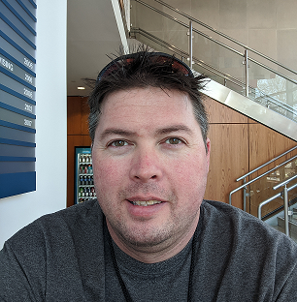
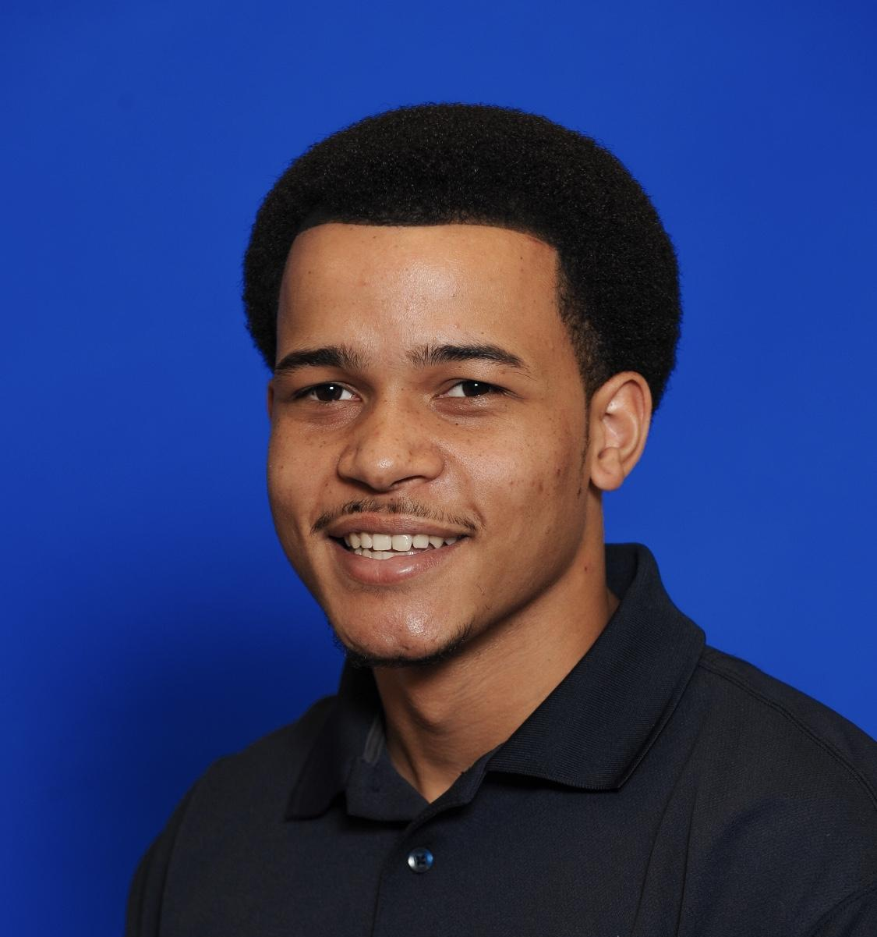

TEAM CRYSTAL
Team Crystal, comprised of computer science students at Old Dominion University, is developing the A³ framework.
Stephen Ayers
Algorithms Developer/Testing
Joshua Murphy
Database Architect
Joshua Harris
Solutions Architect/Testing
Mike Campbell
Database Developer/Algorithms
Aaron Berman
Team Lead/Webmaster
Noah Jennings
Algorithms Developer-UI/UX Developer
Rosalie Oliva
UI/UX Developer
Notes:
Stephen Ayers
introduce the team - everyone says their own name--mention the section you’re covering(?)add under name what section each member is focusing on
rosalie couldn’t make it

Slide 3

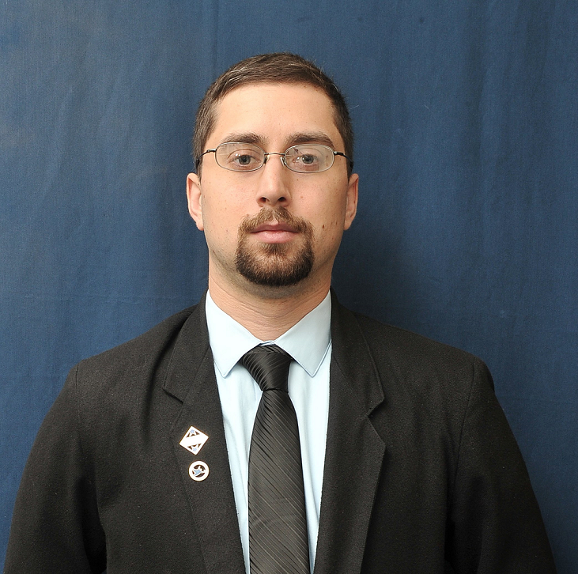
TEAM MENTORS
Janet Brunelle and Thomas Kennedy are both serving as mentors to Team Crystal in developing the A³ framework. Our mentors contributed heavily, explaining their needs and how other services have not been able to fill those needs. A³ seeks to fulfill those needs.
Janet Brunelle
Thomas Kennedy
Notes:
stephen Ayers

Slide 4
OUTLINE
Problem Statement
Traditional Shortcomings
Current Process Flow
Solution Statement
Solution Characteristics
Solution Process Flow
Major Functional Components
UI/UX Elements
Potential User-base
Competition Matrix
Risk Matrix
Conclusion
References
Notes:
Stephen Ayers
NEEDS TO BE UPDATED

Slide 5
PROBLEM STATEMENT
Educators and students lack a framework to aggregate and archive fragmented and domain-specific artifacts for the purpose of academic knowledge management.
Notes:
Stephen
-brunelle mentioned using example of current covid-19 issue, faculty moving to online some without experience on that medium
-faculty have content archives, but the knowledge artifacts aren’t centralized or easy to share with students and other faculty

Slide 6

TRADITIONAL SHORTCOMINGS:
Knowledge Repositories
Formal artifact aggregation in traditional academic environments does not exist [14]
The aggregation that does currently exist does not support tracking of changes [15]
Current aggregation is not strong enough to be considered centralized

Slide 7

TRADITIONAL SHORTCOMINGS:
Knowledge Accessibility
Knowledge is isolated by specialization [16]
Access is often restricted by course or major [16]
Format preference by instructor can vary wildly and may not be functional to others [15]
Notes:
Harris
-bolded headers change to shortcomings/issue area
-suggestion to split 6/7 into 4 slides (4 topics, one slide each)

Slide 8

TRADITIONAL SHORTCOMINGS:
Knowledge Environment Enhancement
Reference materials are specific to each course
ODU instructors use a variety of platforms (Bb, PLE, CoWeM) [15]
Special needs and distance learning lack proper support [14]
Shared reference material can benefit organizations on a fundamental level [16]
Notes:
Harris

Slide 9

TRADITIONAL SHORTCOMINGS:
Knowledge Asset Management
Instructor materials are often created in variety of formats
Individual instructors must often be petitioned for information [15]
Loss of artifacts from reassignment of responsibilities [16]
ODU CS department syllabi collection once took two months [15]
Notes:
Harris

Slide 10
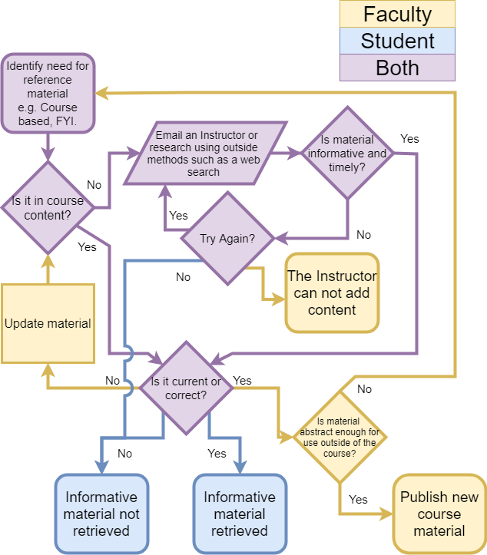
CURRENT PROCESS FLOW
The process flow when viewed from a comprehensive standpoint

Slide 11
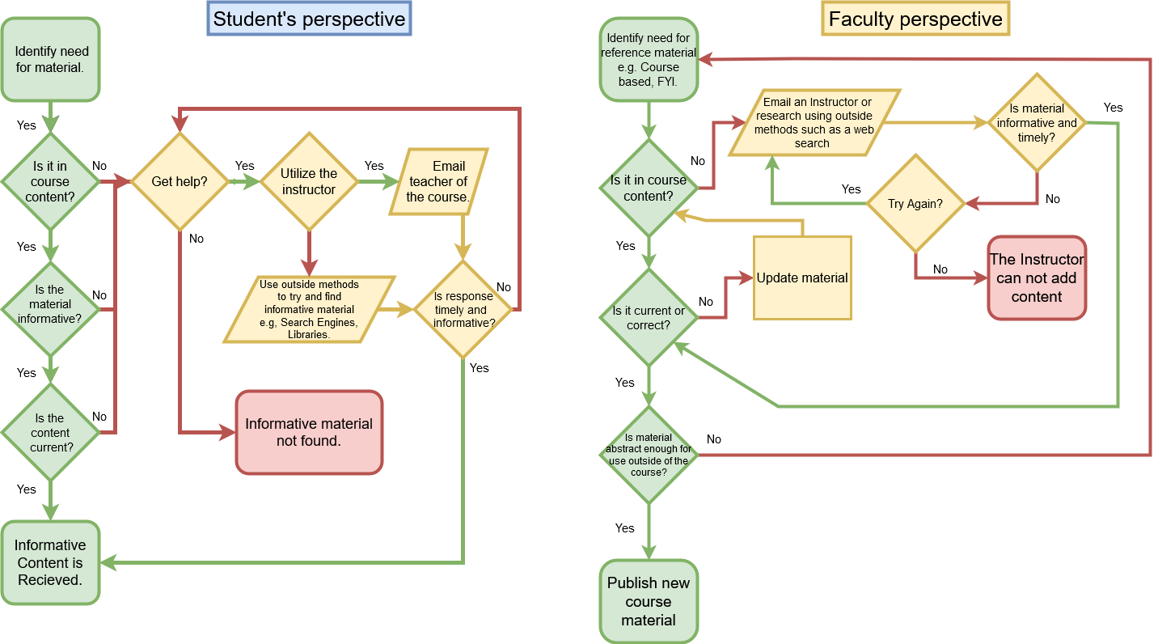
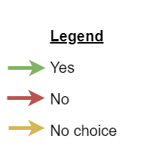
Notes:
Harris

Slide 12
SOLUTION STATEMENT
A³ is a framework for aggregating and archiving artifacts for educators, researchers, and students. A³ seeks to overcome the challenges of individualization, location, and formatting in academic knowledge management by keeping information available, normalized, and centralized while being enhanced by a robust user interface.
Notes:
Stephen Ayers

Slide 13
SOLUTION CHARACTERISTICS:
Creating Formal Knowledge Repositories
Create a robust infrastructure for artifacts
Support change logs of artifacts and knowledge assets
Centralize information concisely and effectively
Notes:
Mike
A-cubed aims to create a robust, reliable infrastructure as a repository for knowledge artifacts…
...which will support recording changes to those artifacts for review and analysis.
The repository is created as a centralized collection of knowledge assets, facilitating easier sharing of instructional materials.

Slide 14
SOLUTION CHARACTERISTICS:
Improve Knowledge Accessibility
Create knowledge artifacts that are widely applicable
Create an cross course accessibility
Normalize information from varied platforms (Blackboard, PLE, etc.) into translatable formats
Notes:
Mike
Easier sharing means artifacts are more accessible.
Using A-cubed, accessing knowledge will no longer be subject to delays from back-and-forth communications because users will have direct access to the artifacts.
Normalizing, standardizing artifact formats means instructors can easily include artifacts from other courses as supplemental content, providing students with more complete understanding of the material.
Consider a Computer Science course about the history and development of programming languages. The instructor using A-cubed could easily pull up-to-date examples from a course focusing on C++ rather than having to create the same, possibly identical, content from scratch.
Instructor Jim Brunelle publishes weekly materials in various formats for his students.

Slide 15
SOLUTION CHARACTERISTICS:
Knowledge Environment Enhancement
Create universal reference material standards
Core organizational improvements through a cooperative environment
Normalization to allow cross platform functionality
Special needs and distance learning accessibility
Notes:
MIKE
Standardizing content held in the repository improves usability and access, and allows for analysis.
Organizing artifacts is much simpler when they can be analyzed.
Normalized formats can be used on many platforms.

Slide 16
SOLUTION CHARACTERISTICS:
Knowledge Asset Management
Unify formatting among instructors through normalization
Remove necessity of individual asset request
Create systematic storage of vital course information
Automate collection of standard reference materials
Notes:
MIKE
Instructors don’t have to consider format choices when sharing materials--just use what works best for them, not only file types, but platforms, as well.
Recall the earlier example of the history of programming instructor complimenting their course materials with artifacts from a C++ course…
...a student accessing that information doesn’t have to go through the platform used by the C++ course, be it PLE, Blackboard, or another--they simply get direct access to the artifact.
The need for students to request individual knowledge assets from instructors is removed,
because the students gain direct access to the collection of artifacts.
This benefits students because of the quicker access to knowledge, but also consider the time saved for the instructor--no longer flooded with emails requesting course materials.

Slide 17
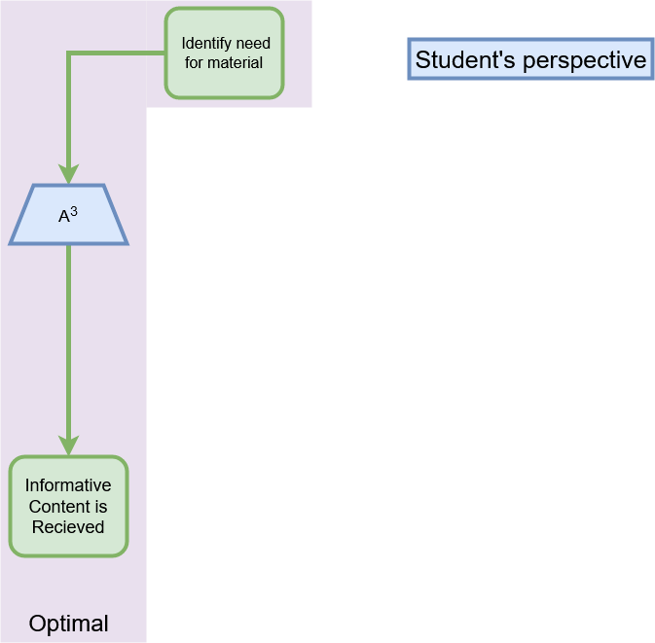
Notes:
Mike
As you can see, the process flow of the student experience is streamlined
optimizing effort, saving time for more last-minute homework

Slide 18
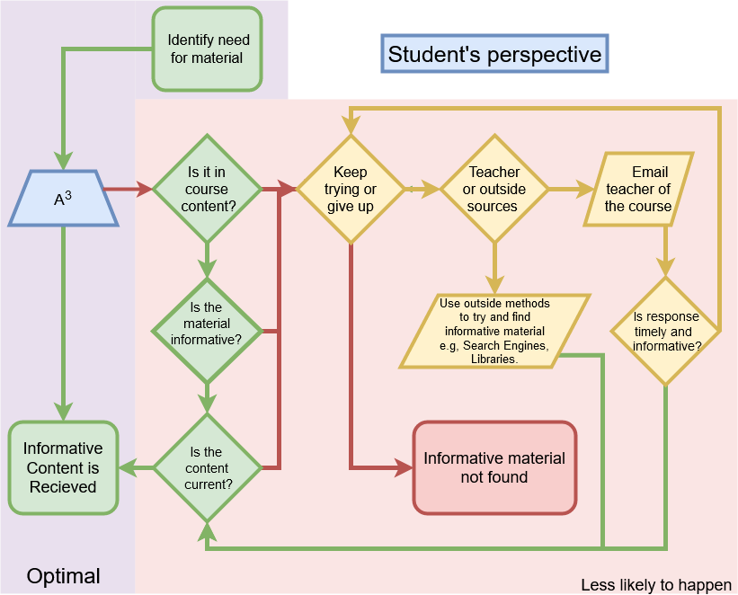
Notes:
Mike
not a panacea, just a tool to improve the process
Hitting a dead end is significantly less likely.

Slide 19
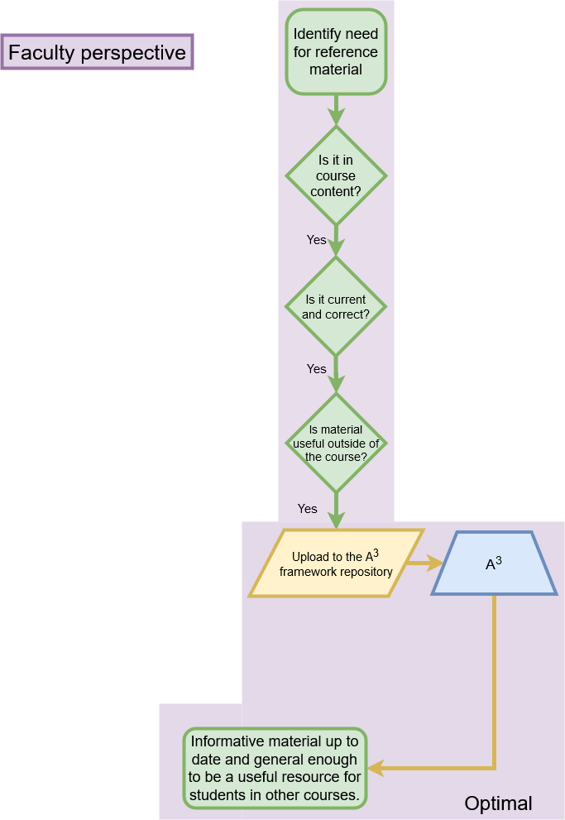
Notes:
Mike
the faculty experience is also simplified
sharing, storing artifacts is more efficient

Slide 20
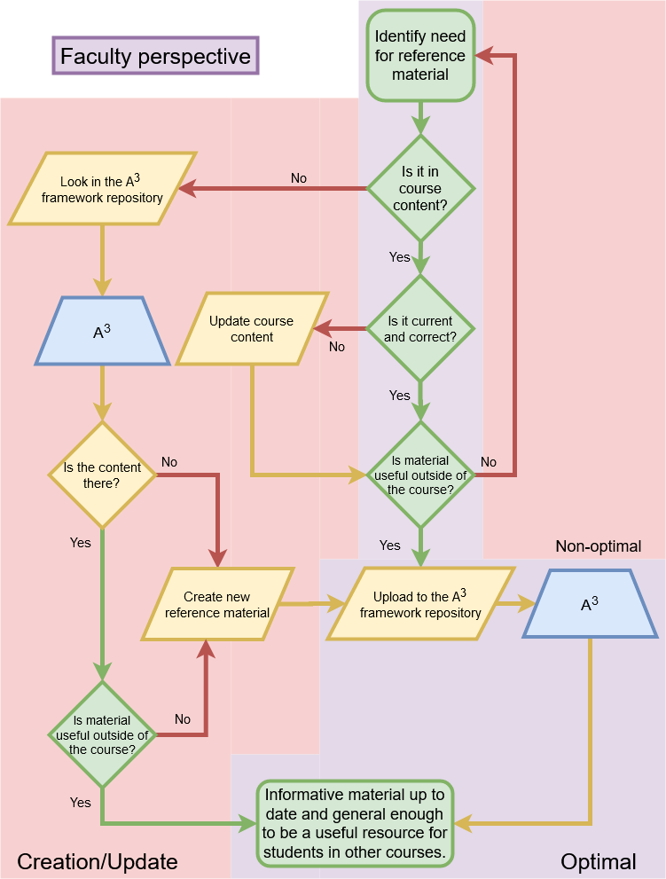
Notes:
Mike
missing content does add steps, but adding content to the course using A-cubed is designed to be easy
benefits grow as participation increases--the more instructors using A-cubed, the better it works for all users.

Slide 21
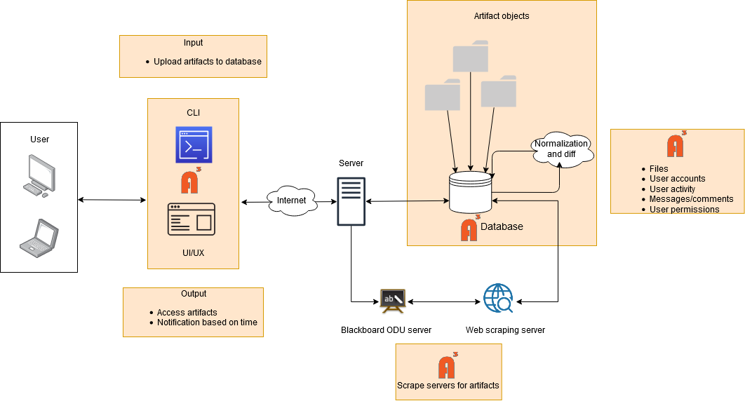
MAJOR FUNCTIONAL
COMPONENTS
Notes:
Harris - Functional components
-need consistent capitalization

Slide 22
UI/UX Elements
Modal Window Popup: This element of the UI will determine what kind of actions each members has the ability to make.
A³ Precision Feedback: Unspecific feedback is often useless. A³ resolves the issue by asking specific questions to the user to create new features.
Deploy: Deliver files in various formats, e.g., pdf, pptx, or html.
Notes:
Stephen Ayers
possible prototype picture??? WIll have to make something
4 interfaces:
-configuration & retrieval: Retrieving data from ODU servers through the framework.
-comparison report: user may compare the new and last set of materials that it was retrieved. However, not every user will have the permission to edit it.
-merge and update: Base on authorization member editor allows some user for example faculty members to edit, write, read, gif command or export update materials.
-deploy: files will be deliver to the user in different formats for example: pdf, html, xml, xps, pptx ,etc. If the data it’s an image it will be deliver in JPG, PNG format.

Slide 23
Potential User Base (Worldwide)
All Enrollments and Online Enrollments, 2016 and 2017
 | 2016 | % of 2016 total | 2017 | % of 2017 Total | % Change, 2016 - 17
All Students | 20,224,069 |  | 20,135,159 |  | -0.44%
Enrolled Exclusively Online | 2,974,836 | 14.71% | 3,104,879 | 15.42% | 4.19%
Enrolled in Some Online Courses | 3,325,750 | 16.44% | 3,552,581 | 17.64% | 6.38%
Enrolled in No Online Courses | 13,923,483 | 68.85% | 13,477,699 | 66.94% | -3.31%
Lederman, D. (2018, November 7). Inside Higher Ed. Retrieved March 10, 2020, from https://www.insidehighered.com/digital-learning/article/2018/11/07/new-data-online-enrollments-grow-and-share-overall-enrollment
Notes:
Stephen Ayers

Slide 24
CURRENT COMPETITION
eFileCabinet - A centralized location for all documents and files. Allows for up to 5 TB of storage. The service can break files down into separate departments and folders. eFileCabinet also lacks in the ability to be locally hosted and controlled by system administrators.
Localized Databases - Databases can contain much of the same information. These are generally not easily accessible by many people due the difficulty included creating SQL queries and data retrieval.
FileCloud - A cloud-based solution to sharing files among students, faculty and administrators. Lacks the ability to be locally hosted and controlled a University.
Notes:
Noah Jennings
Sharepoint ??
what is it
what can it do
how well can it do these things
what can’t it do
why not
eFileCabinet
central location for files/documents with the ability to compartmentalize
lacking the ability to be hosted locally
cannot be controlled by systems admin
Local DB
recurring information
data retrieval and query
locally hosted and controllable
FileCloud
cloud-based file sharing solution
LIKE EFILECABINET lacks the ability to be locally hosted / controlled
GitHub
famous cloud based repo system
contribute to projects in a group/solo

Slide 25
CURRENT COMPETITION
GitHub - A cloud-based repository system for contributing to projects. This is an all-to-one system where the users all contribute to one project. Useful for Programing and its associated documentation.
SharePoint - A cloud-based platform that contains the tools of Microsoft Office while allowing collaborative work. Sharepoint is often presented as a document storage and management system, but is fairly customizable.
Notes:
Noah Jennings
Sharepoint ??
what is it
what can it do
how well can it do these things
what can’t it do
why not
eFileCabinet
central location for files/documents with the ability to compartmentalize
lacking the ability to be hosted locally
cannot be controlled by systems admin
Local DB
recurring information
data retrieval and query
locally hosted and controllable
FileCloud
cloud-based file sharing solution
LIKE EFILECABINET lacks the ability to be locally hosted / controlled
GitHub
famous cloud based repo system
contribute to projects in a group/solo

Slide 26
COMPETITION MATRIX
Features |  | FileCloud | Localized Databases | eFileCabinet | GitHub | SharePoint
File Storage | X | X | X | X | X | X
Change Tracking | X | X | X | X | X | X
Content Search by Filename | X | X | X | X | X | X
File Sharing | X | X |  | X | X | X
Change Reporting | X | X |  |  | X | X
Content Search by Subject | X |  |  | X | X | X
Notifications | X |  |  |  | X | X
Reports | X |  |  |  |  | X
Format Normalization | X
Automation | X
Notes:
Noah Jennings
Key Functionalities of our competition
UI ???
CLI ???
Differences???
least - > greatest
reports was Content by Date
-refers to retrieving details about repository, last accessed files, last changed, access frequency
notifications was Automated Materials Request
-refers to users setting reminders to update their content as applicable
Reports
periodical diff
analyze the state of resources over time
designated by the user or SUM_TIME by default
Format Normalization
so called “normal” forms
reduce redundancy & increase integrity
Automation

Slide 27
RISK MATRIX
Risk ID | Title | Impact | Probability | Mitigation
T1 | Integration with Blackboard - scraping | Significant | Likely | Use of a tool similar to the Blackboard Archive Extractor. Will periodically scrape Blackboard for material and update archive.[10]
T2 | Loss of data | Significant | Unlikely | Will adhere to best practices, as defined by the National Institute of Standards and Technology.[9]
T3 | Information is changed and user is not notified | Significant | Very Unlikely | Unit Testing during development to ensure user is notified of changes.
T4 | File type not supported | Unlikely | Moderate | Will list supported file types
C1 | Faculty does not upload material | Severe | Possible | Will make UI/UX easy to use and understand. School encourage use of A³.
C2 | Does not update material/reference | Significant | Possible | Will allow users to notify them if something has not been update in a certain amount of time. Will allow user to see when last updated.
C3 | Inputs incorrect information | Significant | Possible | System will use backups, information can be reuploaded upon correction.
C4 | Too difficult to use | Moderate | Very Unlikely | Will utilize both a CLI and UI/UX.
Probability
Impact
 | Negligible | Minor | Moderate | Significant | Severe
Very Likely
Likely |  |  |  | T1
Possible |  |  |  | C2, C3 | C1
Unlikely |  |  | T4 | T2
Very Unlikely |  |  | C4 | T3
T#- Technical Risk
C#- Customer Risk
Notes:
Noah Jennings
Referring to the table and the corresponding risk analytical chart,
T1
used with BB
scraping to update
periodically scrape BB
T2
failed to notify the user
unit testing to ensure notification post changes
T3
data loss
follow NIST guidelines
T4
unsupported file types
disclose supported file types / sizes
C1
faculty fails to upload material
easy to use UI/UX
educate and motivate use of A³
C2
does not update material / reference
notify if resource has not been updated in specified amount of time
C3
Incorrect Information
Backups that are able to be reuploaded upon correction
C4
too difficult
Command line interface, user interface/experience

Slide 28
WHAT A³ WILL DO AND WILL NOT DO
A³ will…
Allow users to view changes to an artifact
Link artifacts to the original source
Allow users to convert documents to markdown for normalization
Automate the update of artifacts
A³ will not…
Allow users to edit archived artifacts
Provide server hosting
Require document templates
Provide continuous integration

Slide 29
Conclusion
is a framework and tool set for Aggregation and Archiving of Artifacts.
Configurable for different environments
Extensible to integrate useful tools as needed
Utilizing
Normalization
Automation
Web-scraping
Archival Processes
Notes:
re-do; make it fit as a summary slide
as a simple, digestible format. quick how were fixing
hit 4 points as a highlight
Stephen Ayers

Slide 30
framework A repository of reliable resources.
Our goal is simplicity.
Notes:
Stephen Ayers

Slide 31
REFERENCES
Zeil, S. (2019, December 26). Building the Website. https://www.cs.odu.edu/~zeil/cowem/Public/buildingTheWebsite/index.html
Zeil, S. (2020, January 21). CoWeM - Course Websites From Markdown. https://git-community.cs.odu.edu/zeil/Course_Website_Management
MacFarlane, J. (2006) About pandoc. Pandoc a universal document converter https://pandoc.org/index.html
Kennedy, T. J. (2020, January 21). Home. cs-roars-proposal Wiki. https://git-community.cs.odu.edu/tkennedy/cs-roars-proposal/-/wikis/home
Private File Sharing and Sync for Education. (2020). Retrieved February 20, 2020, from https://www.getfilecloud.com/file-sharing-and-sync-for-education/
Document Management Software. (2020). Retrieved February 20, 2020, from https://www.efilecabinet.com
data loss definition. (n.d.). Retrieved March 10, 2020, from https://csrc.nist.gov/glossary/term/data-loss
data loss prevention. (n.d.). Retrieved March 10, 2020, from https://csrc.nist.gov/glossary/term/data-loss-prevention

Slide 32
REFERENCES cont.
Data Loss Prevention
Blackboard Archive Extractor. (2016, December 15). Retrieved March 10, 2020, from https://www.cs.odu.edu/~cpi/old/411/crystals17/
GitHub features: the right tools for the job. (n.d.). Retrieved March 10, 2020, from https://github.com/features#team-management
Xie, I., & Matusiak, K. K. (2016, July 29). Digital preservation. Retrieved March 10, 2020, from https://www.sciencedirect.com/science/article/pii/B9780124171121000090
Carroll, J., Chun Wei Choo, Dunlap, D., Isenhour, P., Kerr, S., MacLean, A., & Rosson, M. (2003). Knowledge Management Support for Teachers. Educational Technology Research and Development, 51(4), 42-64. Retrieved March 6, 2020, from www.jstor.org/stable/30221184
Davenport, Thomas & Long, M. & Beers, M.. (1997). Building Successful Knowledge Management Projects. Working Paper. 39. Retrieved March 8, 2020, from https://www.researchgate.net/publication/200045855_Building_Successful_Knowledge_Management_Projects

Slide 33
REFERENCES cont.
Thomas Kennedy, project meeting, February 12, 2020
Janet Brunelle, project meeting, March 2, 2020

